Slide 1
Fundamentals of Electric Grid Transmission Plannning
Talk 9: Power System Operations:
What a Planner Needs to Know
Tracy Rolstad
Tracy.Rolstad@trinasolar.com

Slide 2
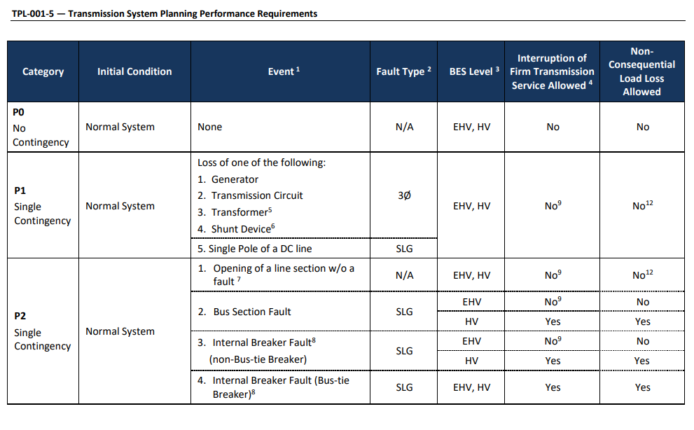
Planning versus Operations
Often using the same tools but the focus IS DIFFERENT
Planners start with All Lines in Service (ALIS)
Then apply NERC TPL-01 P0 to P7 events
Roughly these being N-1 and N-2 events, with N-2 being somewhat related
Future looking
Operations may see multiple outages
TOP standards…
Numerous NERC Standards beyond TOP
Deal with it NOW
1

Slide 3
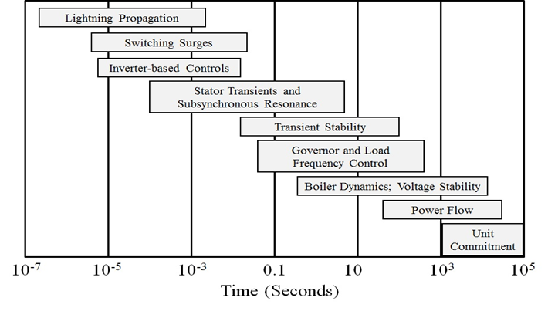
Electric Grid Time Frames
Image: Sauer, P.W., M. A. Pai, Power System Dynamics and Stability, Stripes Publishing, 2007
2

Slide 4
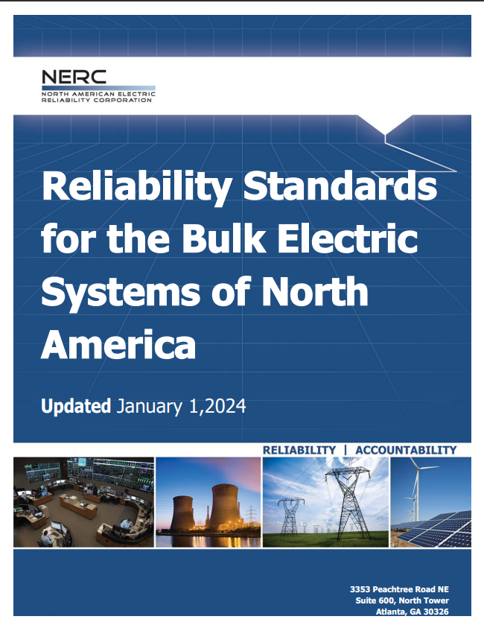
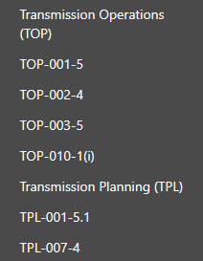
Direct Functional Standards (NERC)
First Glance
But wait, there is more…

Slide 5
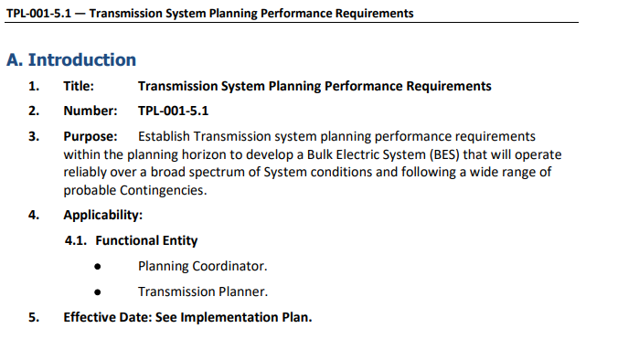
Search the NERC Standards by Functional Entity
Planner’s role
RTO/ISO is the PC
Often, in WECC the TP=PC
Transmission Planner
Spelled out 524 times
Transmission Operator
Spelled out 1,126 times
Take away?
Be a Planner!
Seriously though, Operations deals with many things like Balancing, SCADA, Communications, etc.
Operations get to use what a Planner planned (for better or worse)

Slide 6
Software Study Tools are largely the same
Common software tools:
Power flow, voltage stability, transient stability, short circuit
Operations focused tools:
EMS and SCADA based tools
For example, RTNET and STNET (GE products, formerly Alstom, etc)
Alstom is now exclusively focus on railroad activities
Planning focused tools:
GMD tools and short circuit are good examples of a mostly Planning focus
GMD study periodicity is 5 years, short circuit issues require equipment replacement

Slide 7
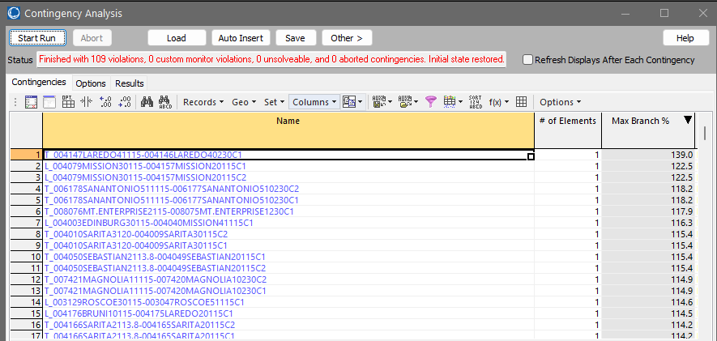
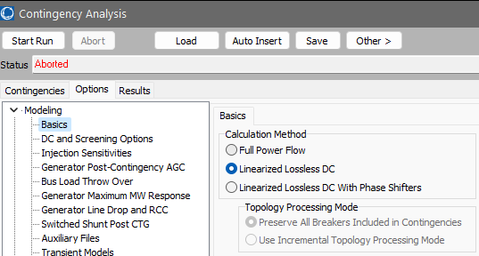
Planner Outcome versus Operations Outcome
Open the ACTIVSg2000 case
Open Ctg Analysis, set Options to
Linearized Lossless DC
We seek speed
Auto insert N-1’s, run them
This is a typical Planners focus

Slide 8
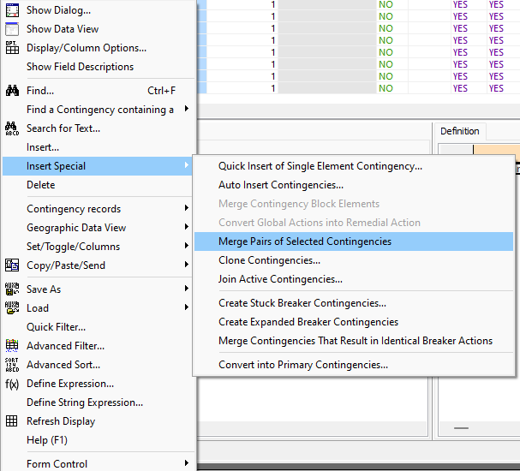
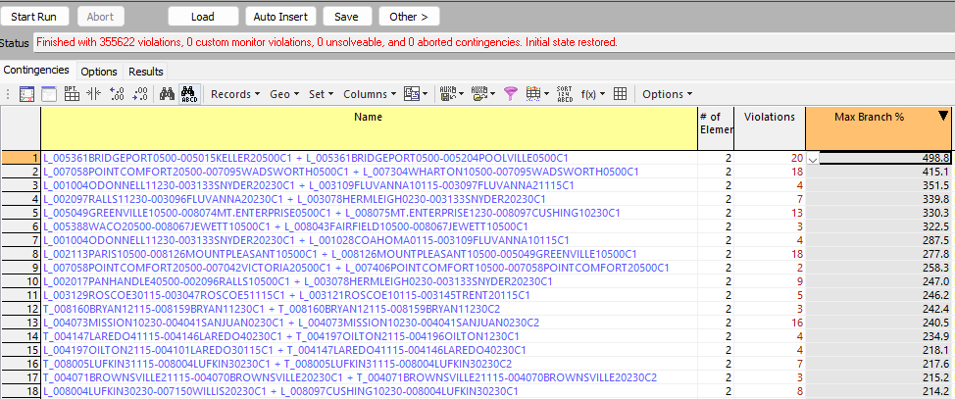
Planner Outcome versus Operations Outcome
Open the ACTIVSg2000 case
Auto insert N-1’s, run them
This is a typical Operators focus
N-2…likely N-4 or N-5 during
construction seasons
140,821 N-2’s evaluated from the merge.
Do NOT do this in class. It takes a bit.
Linear tool suggests these might be worth evaluating

Slide 9
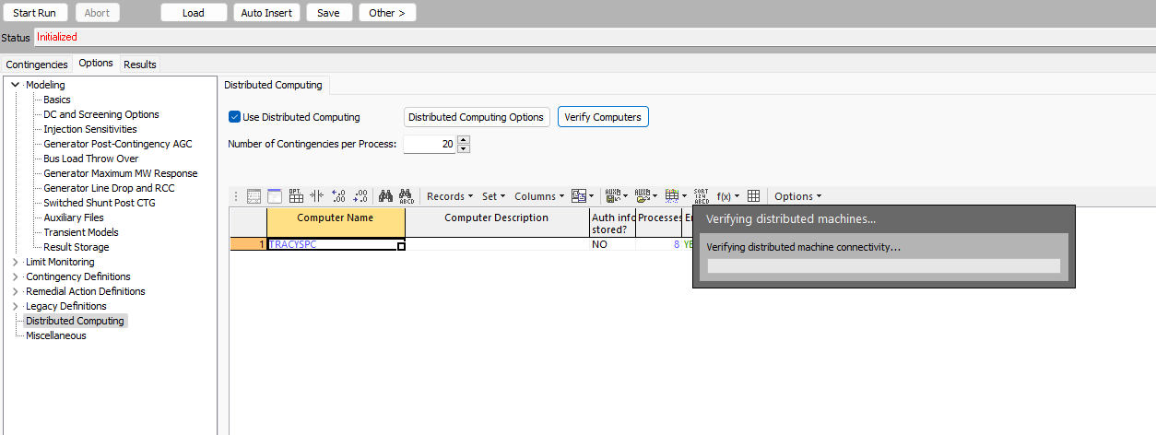
Volumes of contingency runs should be run
Operations staff should consider distributed computing

Slide 10
Planning support to Operations
Planning should screen N-X ctgs to aid Operations in selecting what ctgs need to be considered for daily examination
Linear tools and distributed computing
Distributed tools work for power flow, ATC, and transient stability
Planning to P5, P6, and P7 requirements of TPL-001 is the most robust action Planning can take to support Operations
Plan to unrelated N-2 outages
Plan for adequate service at the end of the amortization period
A project should perform at 40 years as well as year 1 (hence the overbuilt nature of new projects)

Slide 11
Standing orders for Operations format
Purpose
Definitions
Paths, cutplanes, generation groups, nomograms, load groups, associated utilities, etc
Normal Operations
Initial Conditions
Normal Operating Procedures
Set up ALIS for N-1 & N-2 conditions (professional hallmark is to avoid load shedding)
Contingency Operations
Response to select contingencies
Supplementary procedures for outage conditions
Operations can shed load and switch devices

Slide 12

Planning does advance work
Powerflow
PTDF’s, OTDF’s, ctg analysis. RAS development
Voltage stability
QV and PV studies
Short circuit analysis
PWS does a reasonable job to size check fault duty
Transient stability
Fault types, timing, etc
Planning supplies *.aux files for Operations use
They SHOULD that is.

Slide 13
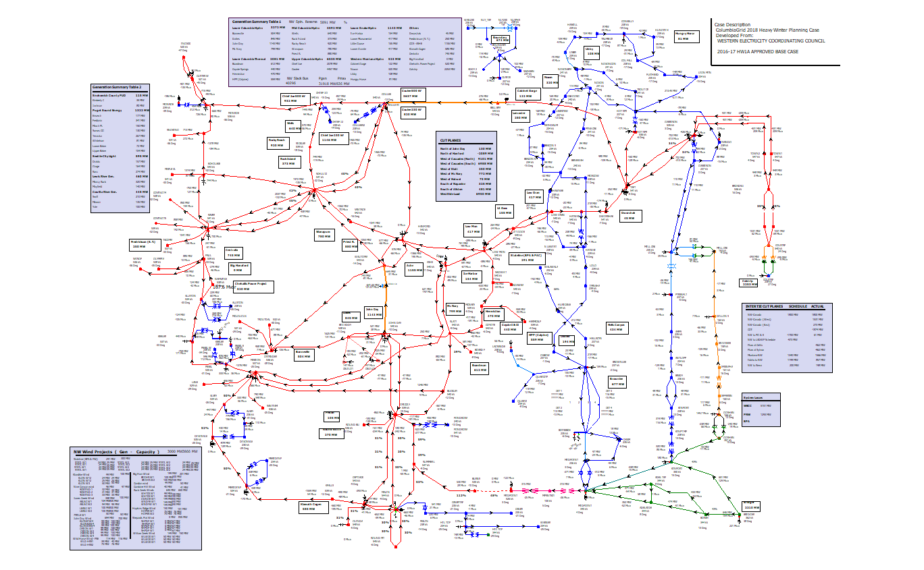
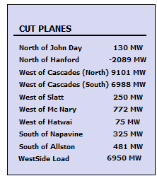
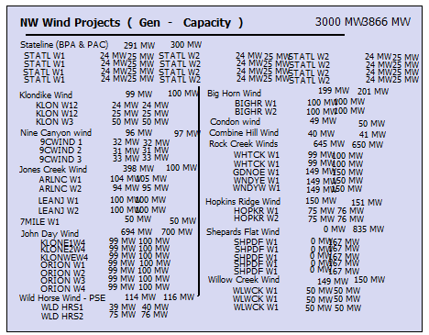
Drawings for example

Slide 14

Most important part is Philosophy
Plan for 30C, 40C, or 50C
FERC Order 881
Planning for 30C is NOT a good practice
Do you want to perform for unrelated N-2’s?
If these don’t perform, they really are related, just not on the same structure, etc
Do you really want to shed load for something that can be planned for?
Load shedding should be reserved just for Operations, and not as a Planning tool
Do NOT plan using emergency ratings!
Really…if you use an emergency rating what does Ops use during an emergency?
20th century mindset…question those past practices

Slide 15
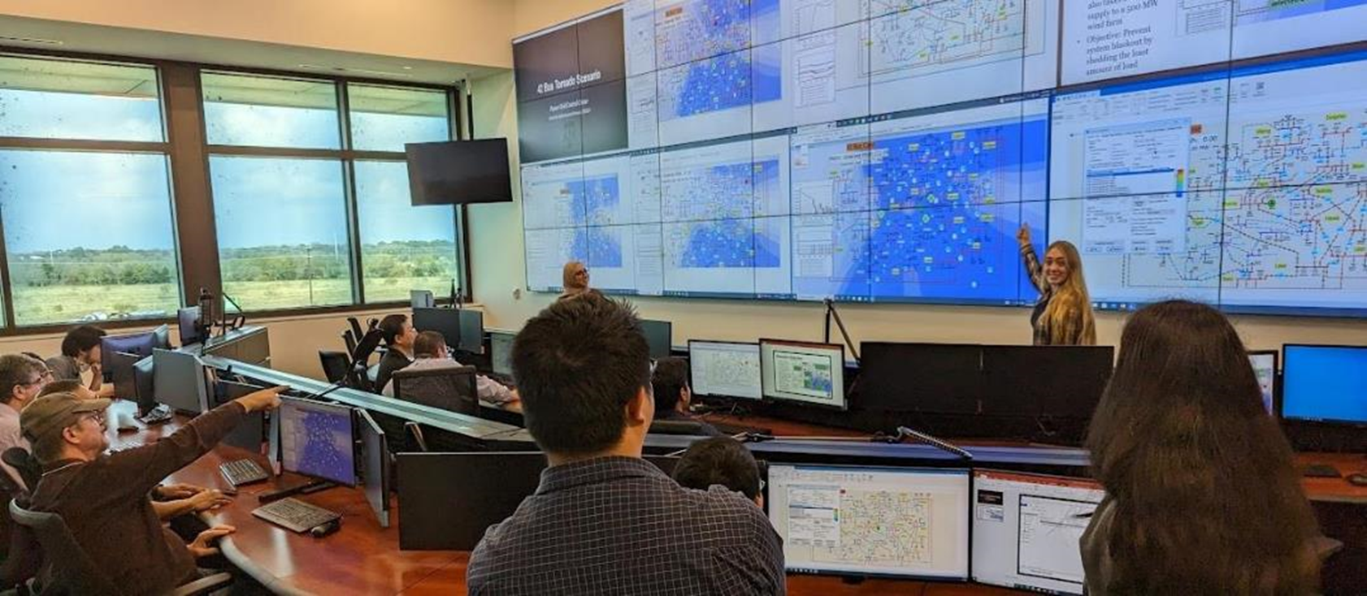
Questions?
14

